Slide 1
Scheduling of Aperiodic and Sporadic Tasks
Lecturer: BuiHa Duc, PhD
Department of Mechatronics

Slide 2
Remind: Types of task
Tasks are primarily classified based on their arrival patterns
Periodic Tasks: A set of jobs that are executed repeatedly at regular time intervals.
  They are predictable and their timing parameters are usually well-defined → hard real-time
Aperiodic Tasks: These tasks arrive at irregular, unpredictable intervals in response to random events.
  Their execution requirements are typically soft real-time
Sporadic Tasks: These tasks also arrive at irregular, but they have a guaranteed minimum arrival time between arrivals.
  Their execution requirements are usually hard real-time

Slide 3
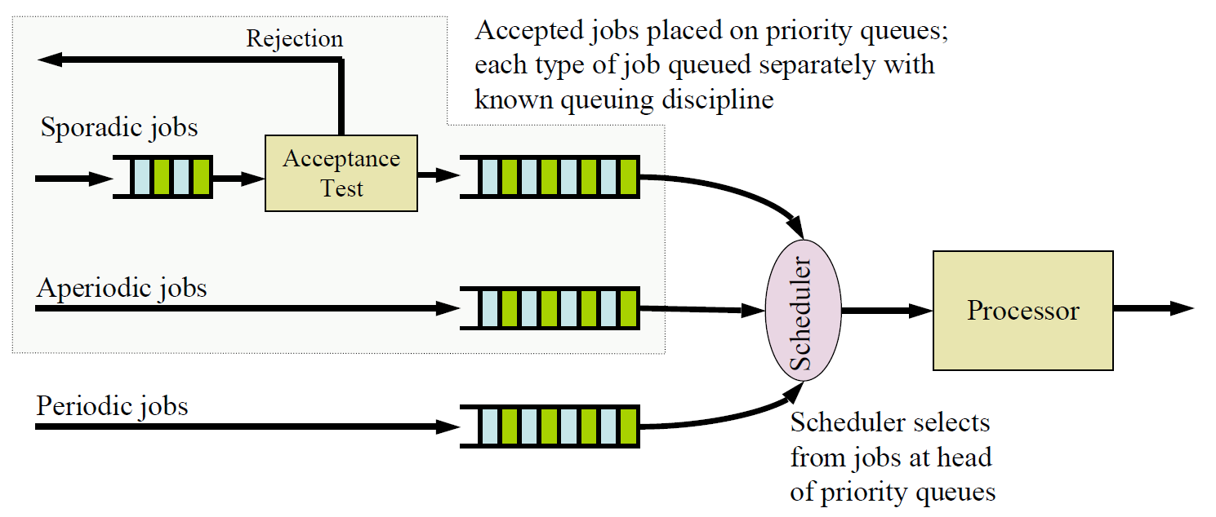
System model

Slide 4
System model
The acceptance test check the execution time and deadline of each newly arrived sporadic job, decide whether to accept or reject the job
  If job can be complete within its deadline → accept
  If cannot guarantee it will meet its deadline → do not accept
Aperiodic jobs are always accepted
A correct schedule is one where all periodic tasks, and any sporadic tasks that have been accepted, meet their deadlines
A scheduling algorithm supporting aperiodic and/or sporadic jobs is a correct algorithm if it only produces correct schedules for the system

Slide 5
System model
An aperiodic job scheduling algorithm is optimal if it minimizes either
  The response time of the job at the head of the aperiodic job queue
  The average response time of all aperiodic jobs for a given queuing discipline
A sporadic job scheduling algorithm is optimal if and only if the new job can be correctly scheduled to complete in time
  An optimal algorithm always produces a feasible schedule job accepted

Slide 6
Scheduling Aperiodic Jobs
Two simple approaches:
  Execute the aperiodic jobs in the background
  Execute the aperiodic jobs by interrupting the periodic jobs
Neither background or interrupt driven execution ideal

Slide 7
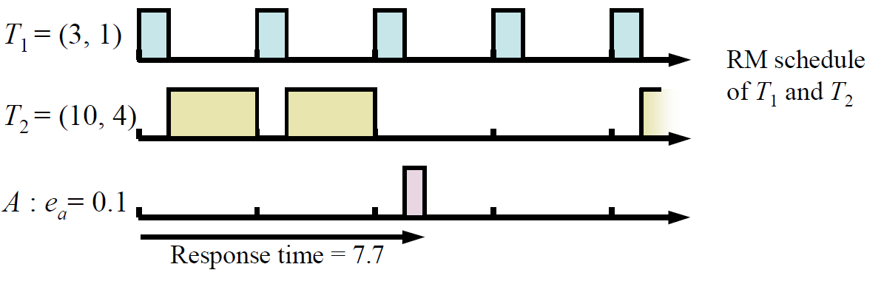
Background Scheduling of Aperiodic Jobs
Aperiodic jobs are scheduled and executed only at times when there are no periodic or sporadic jobs ready for execution
Advantages:
  Clearly produces correct schedules
  Extremely simple to implement
Disadvantages:
  Not optimal due to the delay execution of aperiodic → long response time

Slide 8
Interrupt Scheduling of Aperiodic Jobs
Whenever an aperiodic job arrives, the execution of periodic tasks is interrupted, and the aperiodic job is executed.
  Reduces response times of aperiodic jobs
  But likely not correct, and will often cause periodic/sporadic tasks in the system to miss some deadlines

Slide 9
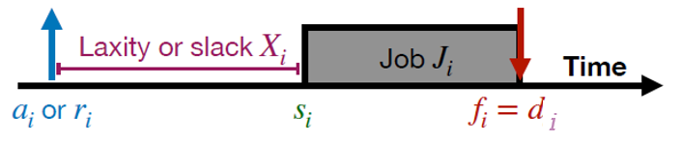
Slack Stealing for Aperiodic Jobs
Idea of slack stealing
Periodic jobs are be scheduled to complete before their deadline → some slack time between completion of the periodic job and its deadline
Move the slack time earlier in the schedule, running periodic jobs ‘just in time’ to meet their deadlines
Execute aperiodic jobs in the slack time, ahead of periodic jobs

Slide 10
Slack Stealing for Aperiodic Jobs
Advantages:
  Reduces response time for aperiodic jobs
  The schedule is correct
Difficulties:
  more complex and difficult to implement
  Pre-computation method such as clock-driven is conceptually simple but not practical in priority-driven system

Slide 11
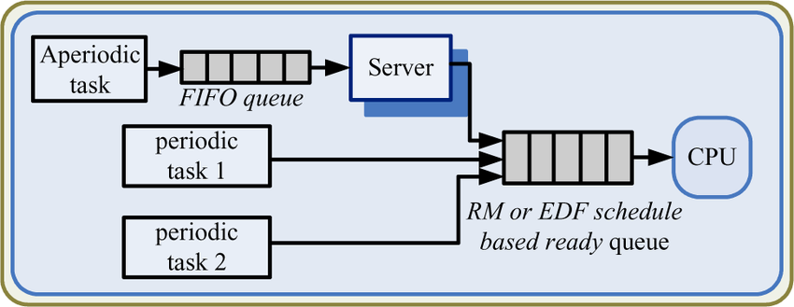
Server-Based Scheduling Algorithms
Server is a special task that is modeled and schedules as a periodic task along side the regular periodic tasks
  Server has a fixed budget C_{s} and period p_{s}
  Task go through a FIFO queue before processing by the server

Slide 12
Server-Based Scheduling Algorithms
The most common and optimized servers
Polling server: when it runs (“poll”), it checks the aperiodic task queue
  Queue not empty → execute the aperiodic tasks up to its budget C_{S}
  Queue empty → server immediately suspends its execution
Advantage:
  Simple, easy to prove correctness
Disadvantage:
  Can only serve aperiodic tasks when it poll → poor response time
  Its responsiveness is highly dependent on the polling period p_{s}

Slide 13
Server-Based Scheduling Algorithms
The most common and optimized servers
Deferrable Server:
  If queue is empty → server defer its budget throughout the period, to be used whenever there are aperiodic jobs to execute
  The budget is replenished on a fixed periodic schedule
  The deferrable server is almost always run at highest priority
  Note: the server is not allowed to carry over budget from period to period
Advantage:
  Improves response time of aperiodic jobs, compared to polling server
Disadvantage:
  may delay lower-priority periodic tasks longer than a true periodic task would → affect the system schedulability

Slide 14
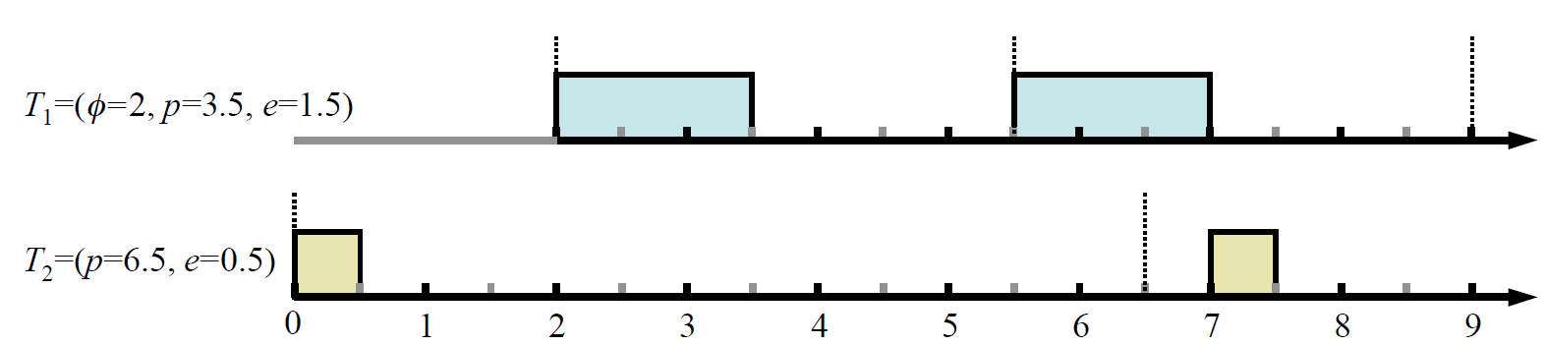
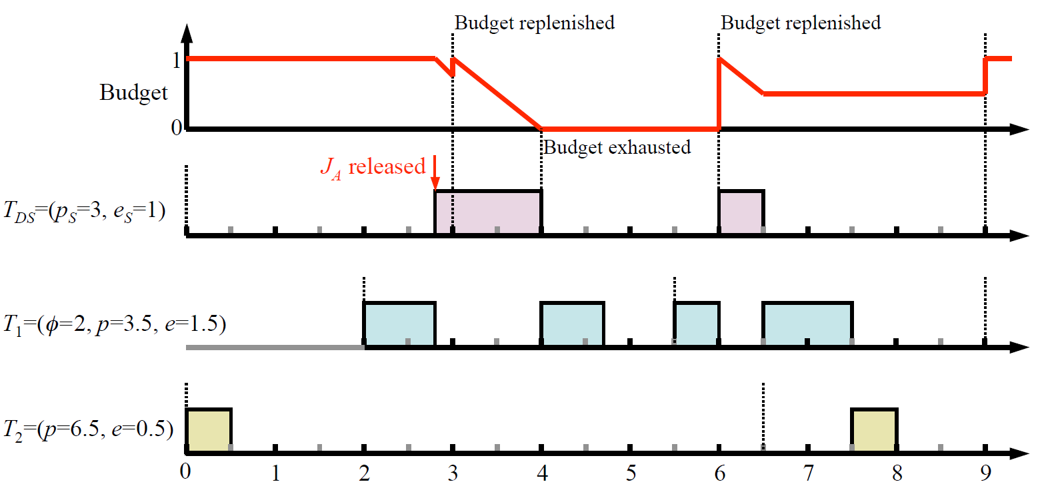

Slide 15
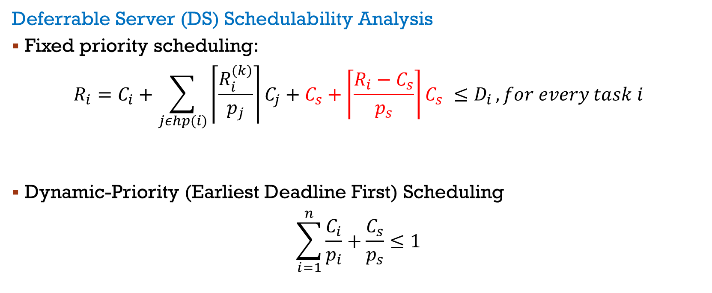
Server-Based Scheduling Algorithms
Deferrable Server (DS) Schedulability Analysis
Fixed priority scheduling:
$$R_{i}=C_{i}+\sum_{jεhp(i)}{\left\lceil \frac{R_{i}^{(k)}}{p_{j}}\right\rceil C_{j}}+C_{s}+\left\lceil \frac{R_{i}−C_{s}}{p_{s}}\right\rceil C_{s} ≤D_{i },for every task i$$
Dynamic-Priority (Earliest Deadline First) Scheduling
$$\sum_{i=1}^{n}{\frac{C_{i}}{p_{i}}+\frac{C_{s}}{p_{s}}≤1}$$

Slide 16
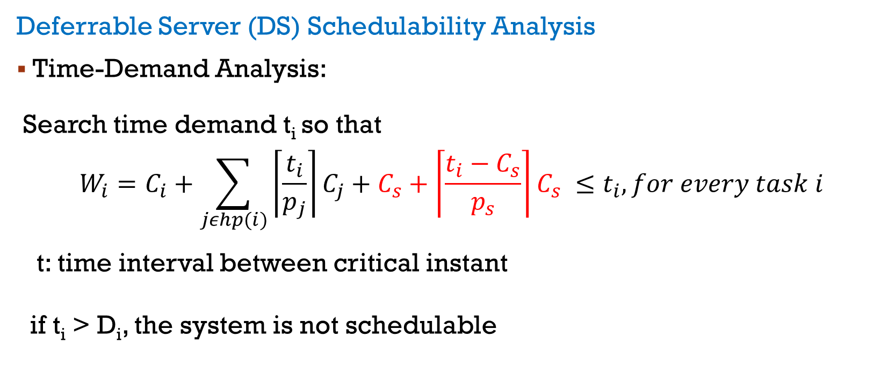
Server-Based Scheduling Algorithms
Deferrable Server (DS) Schedulability Analysis
Time-Demand Analysis:
Search time demand t_{i} so that
$$W_{i}=C_{i}+\sum_{jεhp(i)}{\left\lceil \frac{t_{i}}{p_{j}}\right\rceil C_{j}}+C_{s}+\left\lceil \frac{t_{i}−C_{s}}{p_{s}}\right\rceil C_{s} ≤t_{i},for every task i$$
t: time interval between critical instant
if t_{i} > D_{i}, the system is not schedulable

Slide 17
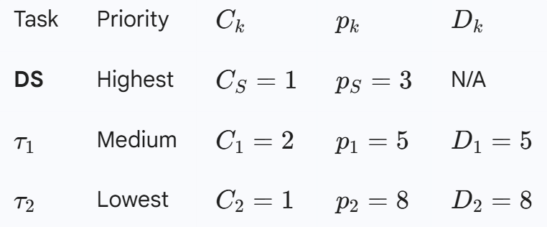
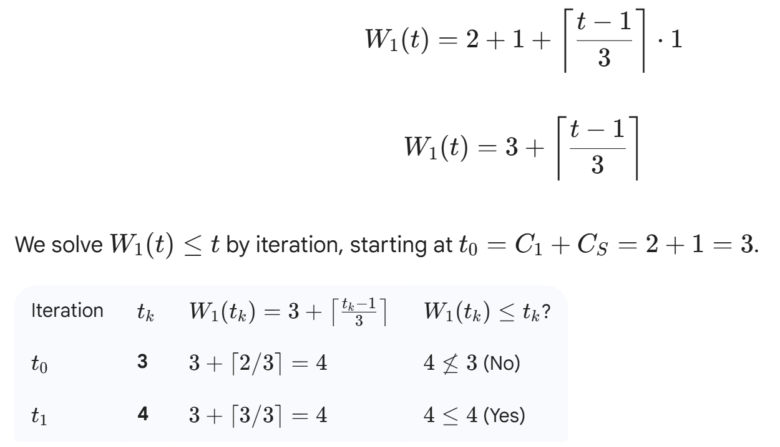
Example

Slide 18
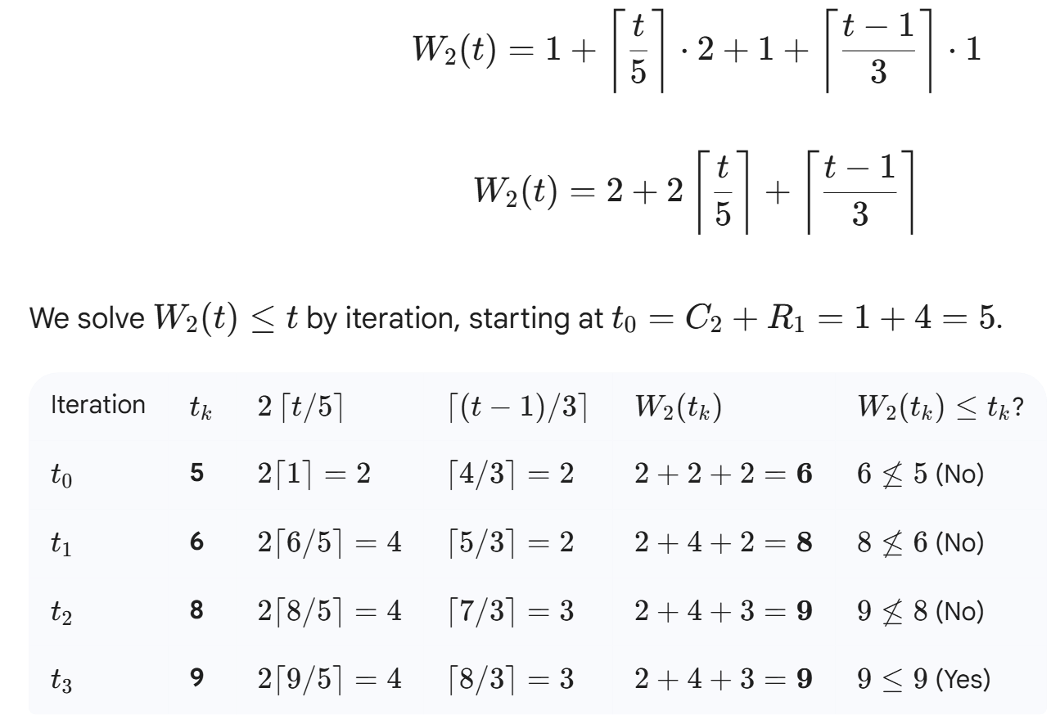
Example

Slide 19
Example
Give following tasks:
Periodic tasks T₁ = (4,1); T₂ = (6,2); T_{DS} = (5,2)
Aperiodic jobs
J₁: arrival at 2, workload 2
J₂: arrival at 8, workload 1
J₃: arrival at 12, workload 2
J₄: arrival at 19, workload 2
Use RMS and Deferrable Server to schedule these tasks

Slide 20
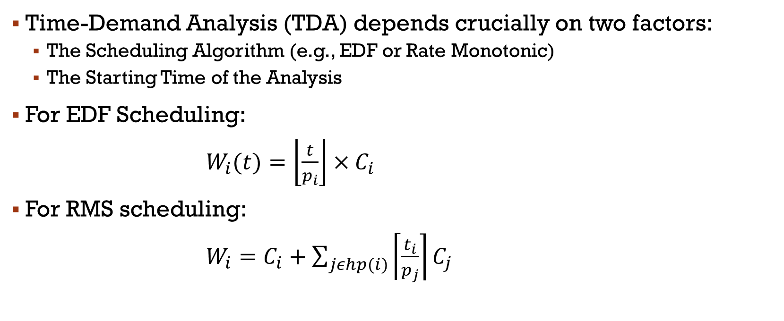
Time-Demand Analysis (TDA)
Time-Demand Analysis (TDA) depends crucially on two factors:
  The Scheduling Algorithm (e.g., EDF or Rate Monotonic)
  The Starting Time of the Analysis
For EDF Scheduling:
$W_{i}(t)=\left\lfloor \frac{t}{p_{i}}\right\rfloor ×C_{i}$
For RMS scheduling:
$W_{i}=C_{i}+\sum_{jεhp(i)}{\left\lceil \frac{t_{i}}{p_{j}}\right\rceil C_{j}}$

Slide 21
Server-Based Scheduling Algorithms
The most common and optimized servers
Sporadic server: one of the most effective and widely used methods for scheduling both hard and soft aperiodic tasks.
  The server is scheduled with a high priority
  Its behavior is governed by sophisticated Consumption and Replenishment rules
  The Sporadic Server only consumes its budget when an aperiodic task is actually running
  The budget is not replenished on a fixed periodic schedule. It is replenished only after it has been consumed.
Advantage:
  can be treated exactly as a periodic in all schedulability analyses.

Slide 22
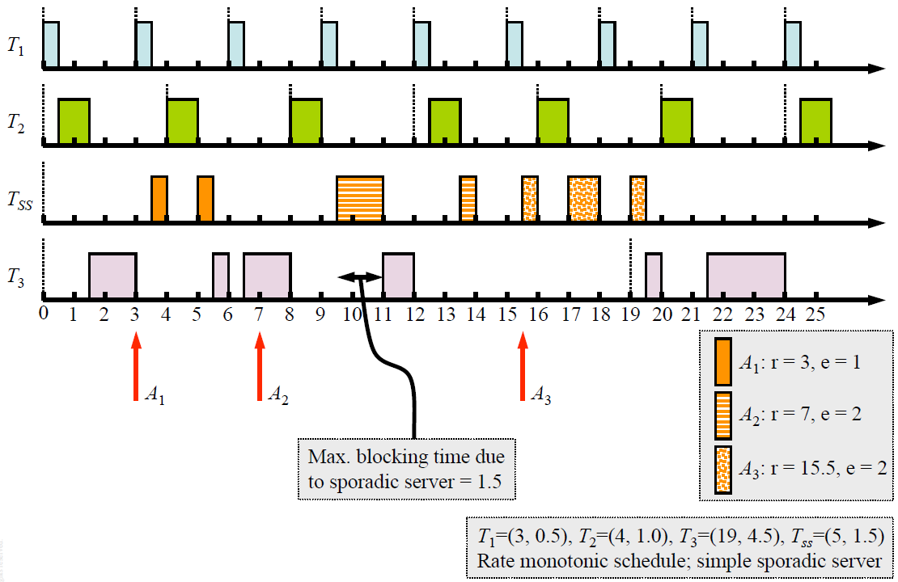

Slide 23
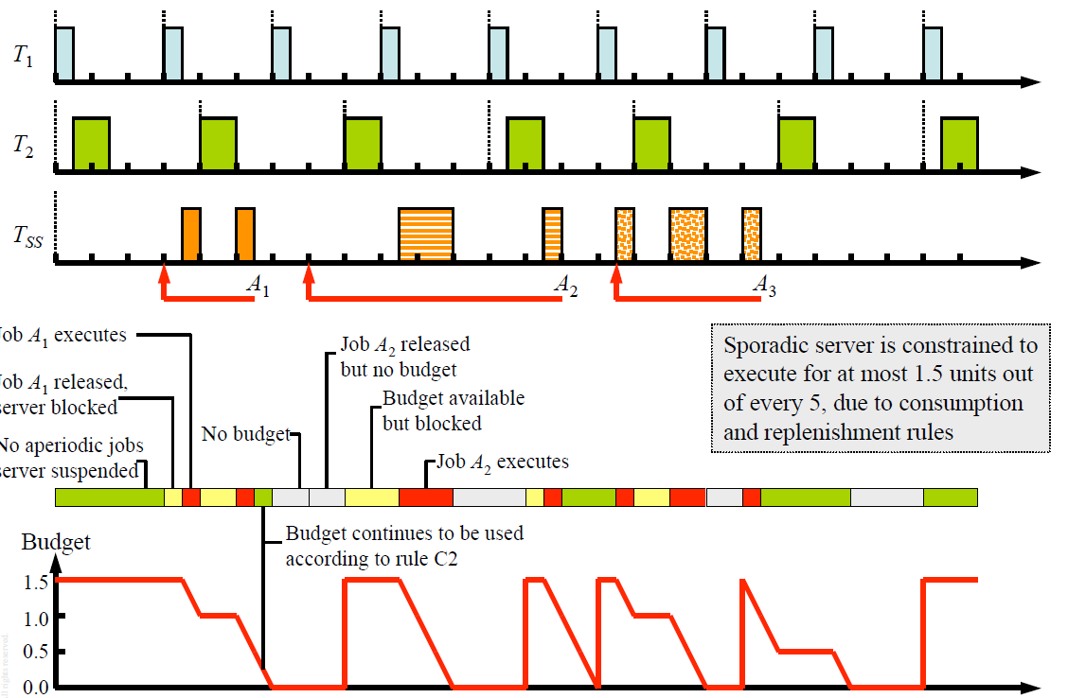

Slide 24
Example
Give following tasks:
Periodic tasks T₁ = (10,3); T₂ = (15,4); T_{SS} = (8,2)
Aperiodic jobs
J₁: arrival at 2, workload 2
J₂: arrival at 7, workload 2
Use RMS and Sporadic Server to schedule these tasks

Slide 25
Advanced bandwidth-preserving Server
Popular Algorithms:
  Constant utilization server
  Total bandwidth server
  Weighted fair queuing server
Typically used in dynamic-priority systems to service aperiodic tasks
Main ideas:
  Aims to provide temporal isolation by giving each task a guaranteed fraction of the CPU time, making each task behave as if it's running on a dedicated, slower processor
  Aims to provide fair sharing, timing isolation, or guaranteed throughput
  Widely used in network scheduling, but can also be used to schedule servers for aperiodic jobs

Slide 26
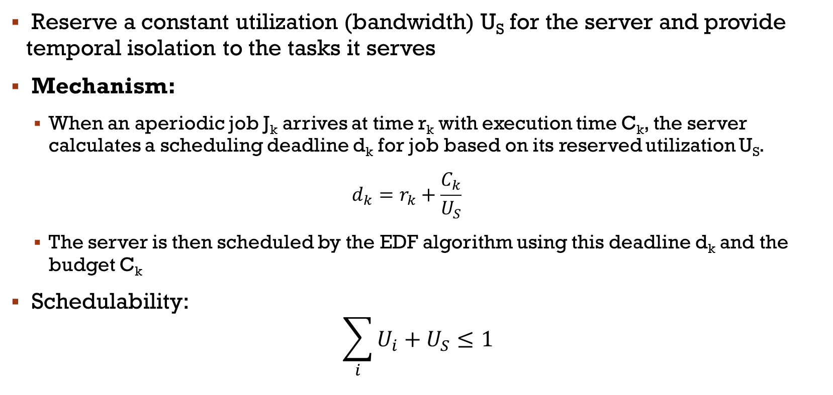
Constant Utilization Server (CUS)
Reserve a constant utilization (bandwidth) U_{S} for the server and provide temporal isolation to the tasks it serves
Mechanism:
  When an aperiodic job J_{k} arrives at time r_{k} with execution time C_{k}, the server calculates a scheduling deadline d_{k} for job based on its reserved utilization U_{S}.
  $$d_{k}=r_{k}+\frac{C_{k}}{U_{S}}$$
  The server is then scheduled by the EDF algorithm using this deadline d_{k} and the budget C_{k}
Schedulability:
$$\sum_{i}{U_{i}+U_{S}≤1}$$

Slide 27
Constant Utilization Server (CUS)
Rules:
  The CUS only consumes its budget when it is active
  The server only generates a new deadline when a new job arrives and the server is idle.
  If the aperiodic queue is empty, the server becomes idle and its budget/deadline is effectively reset

Slide 28
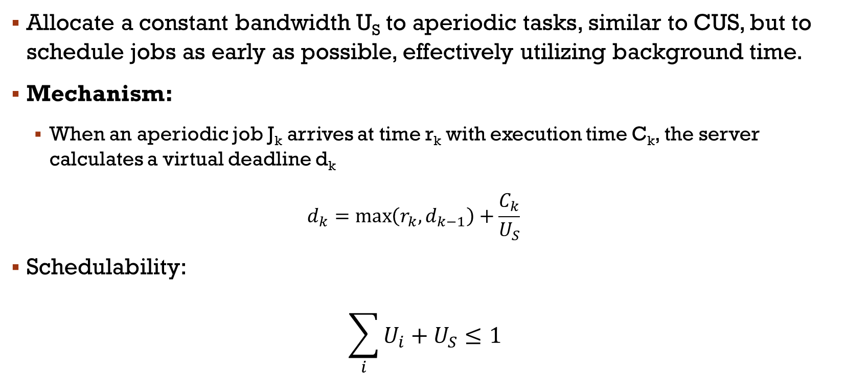
Total Bandwidth Server (TBS)
Allocate a constant bandwidth U_{S} to aperiodic tasks, similar to CUS, but to schedule jobs as early as possible, effectively utilizing background time.
Mechanism:
  When an aperiodic job J_{k} arrives at time r_{k} with execution time C_{k}, the server calculates a virtual deadline d_{k}
  $$d_{k}=\max\left(r_{k},d_{k−1}\right)+\frac{C_{k}}{U_{S}}$$
Schedulability:
$$\sum_{i}{U_{i}+U_{S}≤1}$$

Slide 29
Total Bandwidth Server (CUS)
Rules:
  Deadline calculation ensures that the server's utilization never exceeds U_{S}
  The server tends to assign earlier deadlines than a CUS → shorter aperiodic response times

Slide 30
Scheduling Sporadic jobs
The acceptance test check the execution time and deadline of each newly arrived sporadic job
If job can be complete within its deadline → accept
If cannot guarantee it will meet its deadline → do not accept
How to implement acceptance test ?

Slide 31
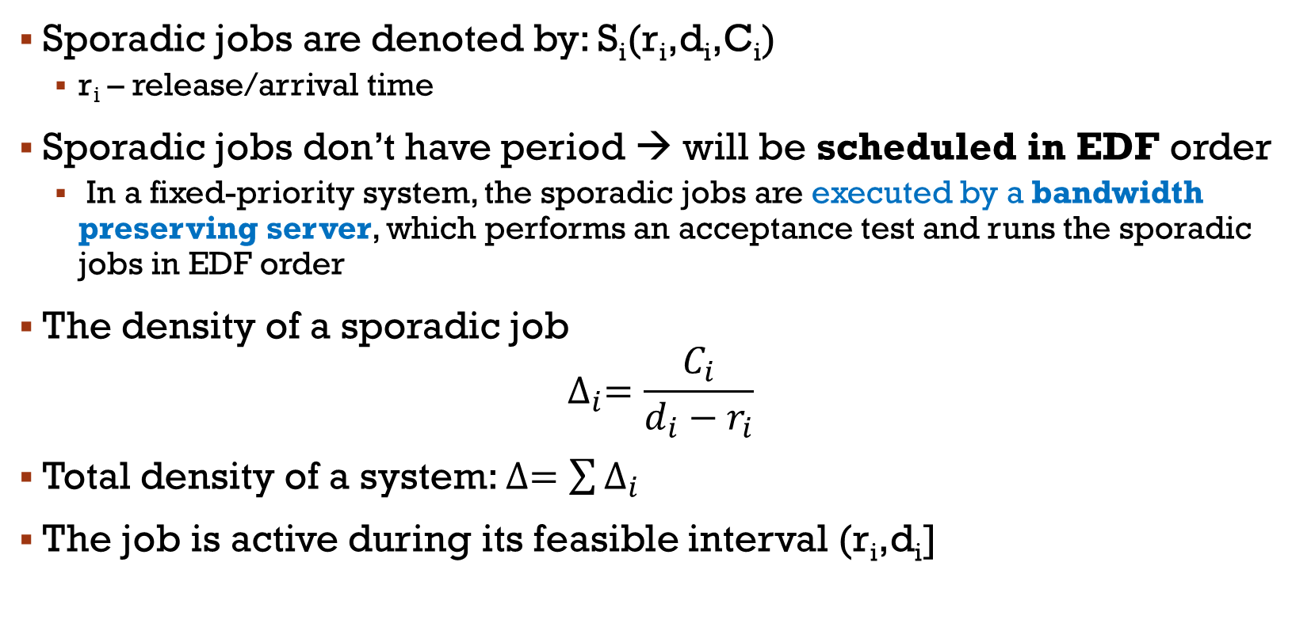
Scheduling Sporadic jobs
Sporadic jobs are denoted by: S_{i}(r_{i},d_{i},C_{i})
  r_{i} – release/arrival time
Sporadic jobs don’t have period → will be scheduled in EDF order
  In a fixed-priority system, the sporadic jobs are executed by a bandwidth preserving server, which performs an acceptance test and runs the sporadic jobs in EDF order
The density of a sporadic job
$$∆_{i}=\frac{C_{i}}{d_{i}−r_{i}}$$
Total density of a system: $∆=\sum{∆_{i}}$
The job is active during its feasible interval (r_{i},d_{i}]

Slide 32
Scheduling Sporadic jobs
Theorem: A system of independent preemptable sporadic jobs is schedulable according to the EDF algorithm if the total density of all active jobs in the system ≤ 1 at all times
  This is the standard schedulability test for EDF systems, but including both periodic and sporadic jobs
  This test uses the density since deadlines may not equal periods; hence it is a sufficient test, but not a necessary test
When a sporadic job arrives → calculate the total density ∆
  If ∆ > 1 in its feasible interval → reject the job

Slide 33
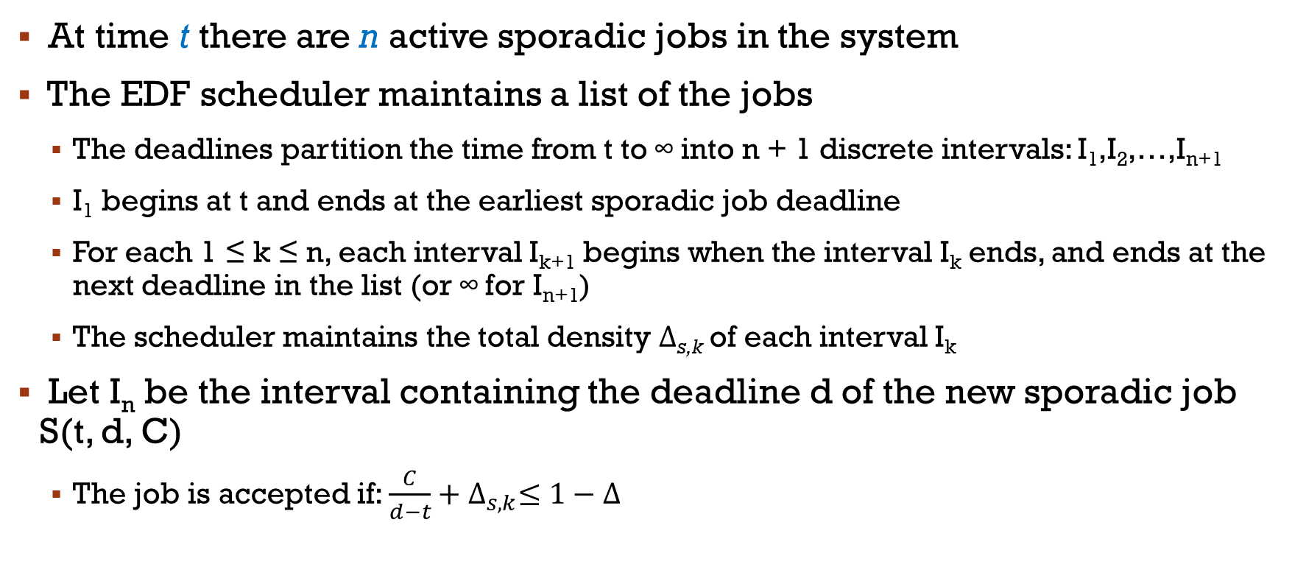
Admission Control for Sporadic Jobs
At time t there are n active sporadic jobs in the system
The EDF scheduler maintains a list of the jobs
  The deadlines partition the time from t to ∞ into n + 1 discrete intervals: I₁,I₂,…,I_{n+1}
  I₁ begins at t and ends at the earliest sporadic job deadline
  For each 1 ≤ k ≤ n, each interval I_{k+1} begins when the interval I_{k} ends, and ends at the next deadline in the list (or ∞ for I_{n+1})
  The scheduler maintains the total density Δ_{s,k} of each interval I_{k}
Let I_{n} be the interval containing the deadline d of the new sporadic job S(t, d, C)
  The job is accepted if: $\frac{C}{d−t}+∆_{s,k}≤1−∆$

Slide 34
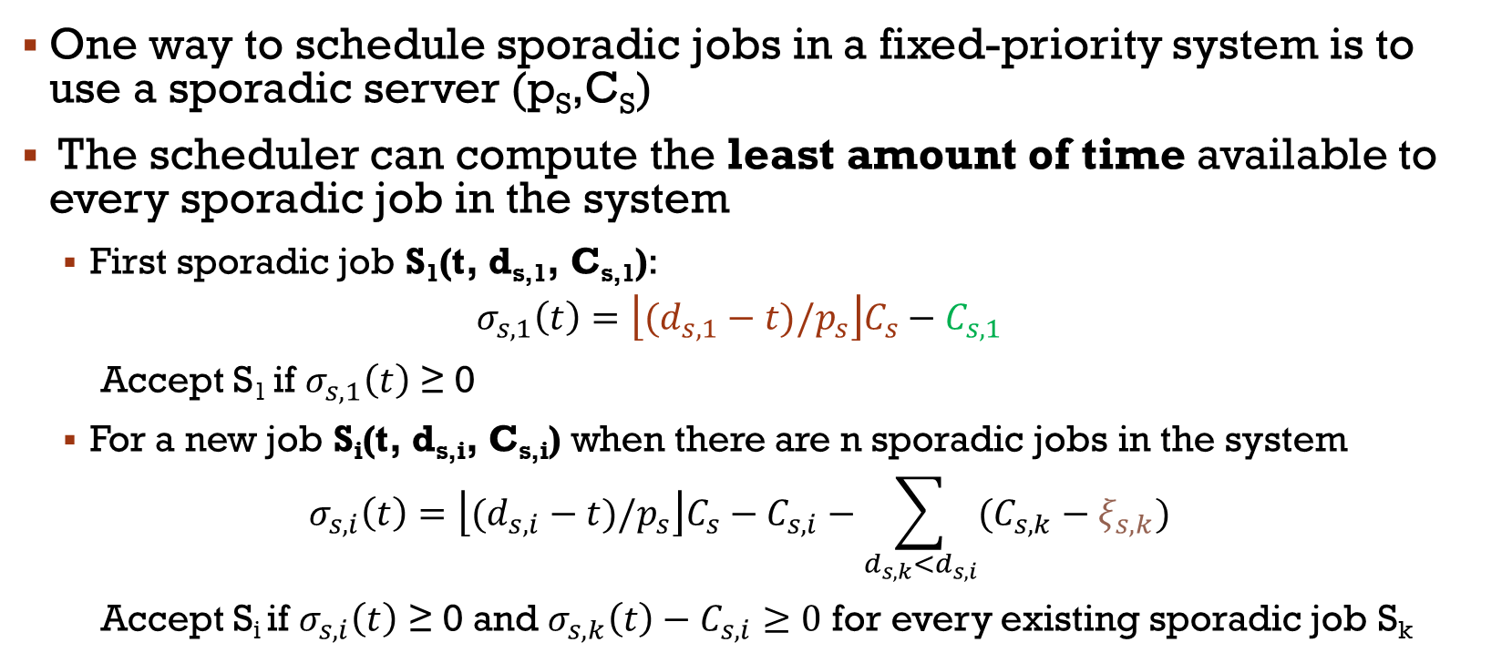
Sporadic Jobs in Fixed-Priority Systems
One way to schedule sporadic jobs in a fixed-priority system is to use a sporadic server (p_{S},C_{S})
The scheduler can compute the least amount of time available to every sporadic job in the system
  First sporadic job S₁(t, d_{s,1}, C_{s,1}):
  $$σ_{s,1}\left(t\right)=\left\lfloor (d_{s,1}−t)/p_{s}\right\rfloor C_{s}−C_{s,1}$$
  Accept S₁ if $σ_{s,1}\left(t\right)$ ≥ 0
  For a new job S_{i}(t, d_{s,i}, C_{s,i}) when there are n sporadic jobs in the system
  $$σ_{s,i}\left(t\right)=\left\lfloor (d_{s,i}−t)/p_{s}\right\rfloor C_{s}−C_{s,i}−\sum_{d_{s,k}<d_{s,i}}{(C_{s,k}−ξ_{s,k})}$$
  Accept S_{i} if $σ_{s,i}\left(t\right)$ ≥ 0 and $σ_{s,k}\left(t\right)−C_{s,i}≥0$ for every existing sporadic job S_{k}
Time available
Execution time
Execution time of job S_{k}

Slide 35
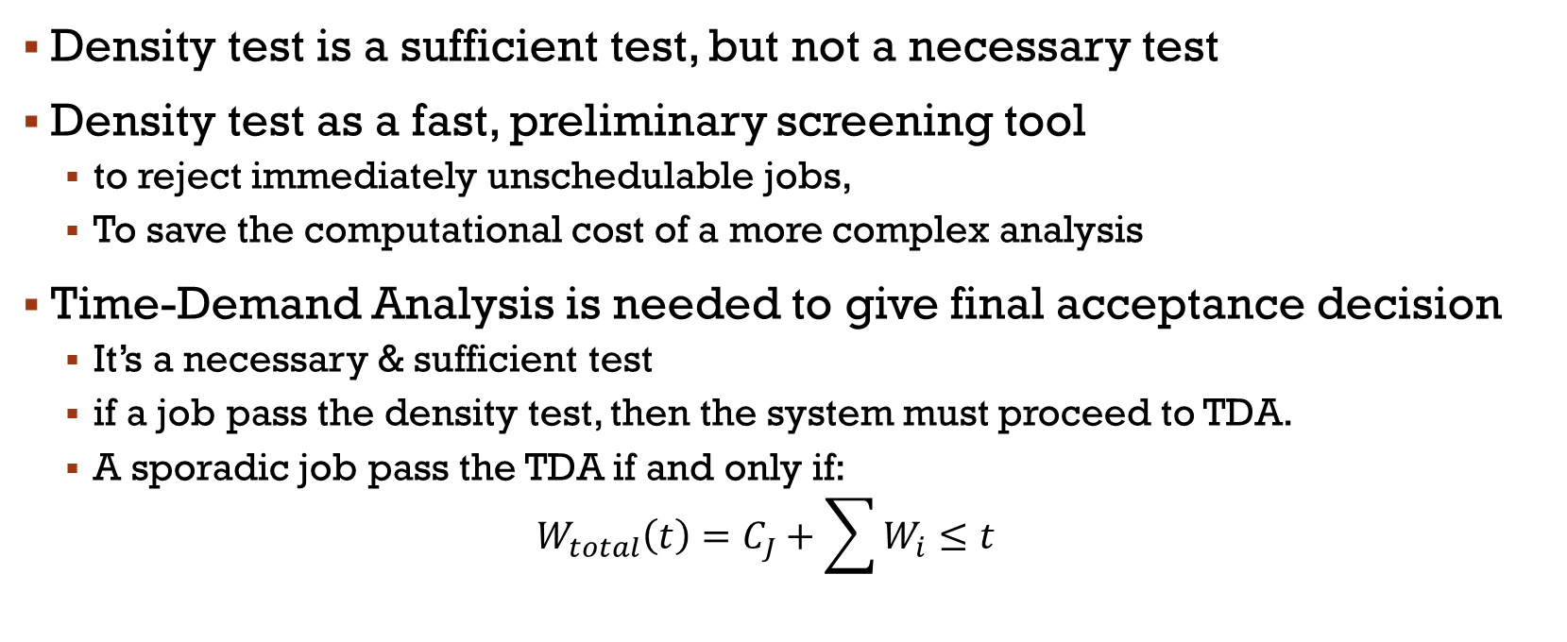
NoteS
Density test is a sufficient test, but not a necessary test
Density test as a fast, preliminary screening tool
  to reject immediately unschedulable jobs,
  To save the computational cost of a more complex analysis
Time-Demand Analysis is needed to give final acceptance decision
  It’s a necessary & sufficient test
  if a job pass the density test, then the system must proceed to TDA.
  A sporadic job pass the TDA if and only if:
  $$W_{total}\left(t\right)=C_{J}+\sum{W_{i}}≤t$$

Slide 36
Example
Given a system with 3 high priority periodic task:
T₁=(20,5); T₂=(50,10); T₃=(100,15)
a. At t = 30ms, a new sporadic job J_{S1} arrives
J_{S1}=(30,55,20)
b. At t = 100ms, a new sporadic job J_{S2} arrives
J_{S2}=(100,125,10)
Can these sporadic jobs pass the acceptance test?

Slide 37
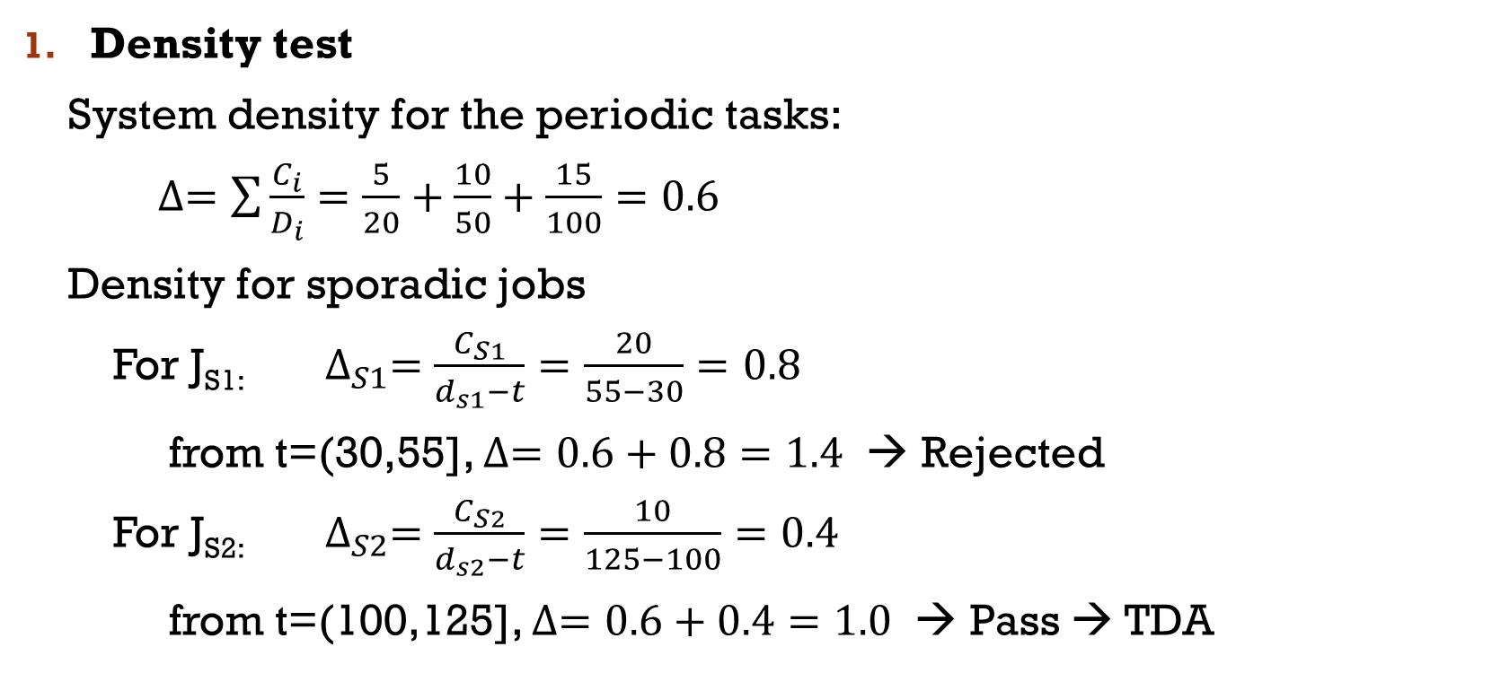
Example
Density test
System density for the periodic tasks:
$∆=\sum{\frac{C_{i}}{D_{i}}}=\frac{5}{20}+\frac{10}{50}+\frac{15}{100}=0.6$
Density for sporadic jobs
For J_{S1:} $∆_{S1}=\frac{C_{S1}}{d_{s1}−t}=\frac{20}{55−30}=0.8$
from t=(30,55], $∆=0.6+0.8=1.4$ → Rejected
For J_{S2:} $∆_{S2}=\frac{C_{S2}}{d_{s2}−t}=\frac{10}{125−100}=0.4$
from t=(100,125], $∆=0.6+0.4=1.0$ → Pass → TDA

Slide 38
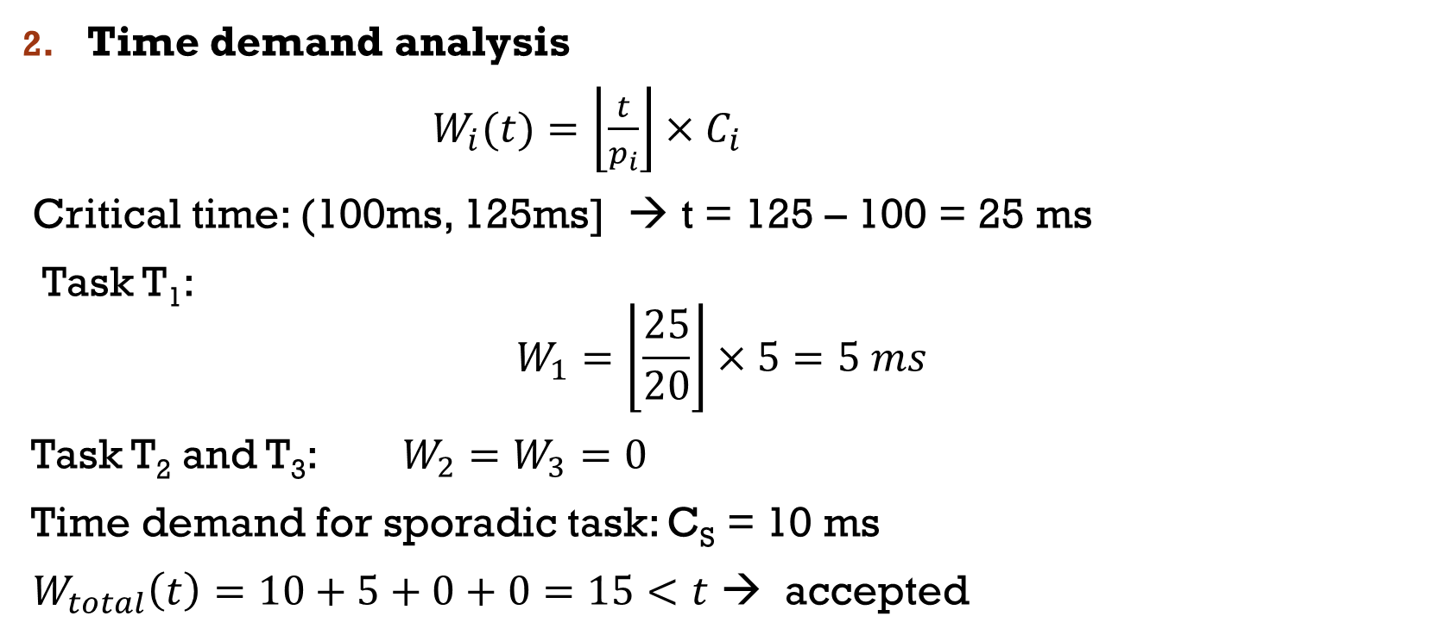
Example
Time demand analysis
$W_{i}(t)=\left\lfloor \frac{t}{p_{i}}\right\rfloor ×C_{i}$
Critical time: (100ms, 125ms] → t = 125 – 100 = 25 ms
Task T₁:
$$W_{1}=\left\lfloor \frac{25}{20}\right\rfloor ×5=5 ms$$
Task T₂ and T₃: $W_{2}=W_{3}=0$
Time demand for sporadic task: C_{S} = 10 ms
$W_{total}\left(t\right)=10+5+0+0=15<t$ → accepted

